Slide 1
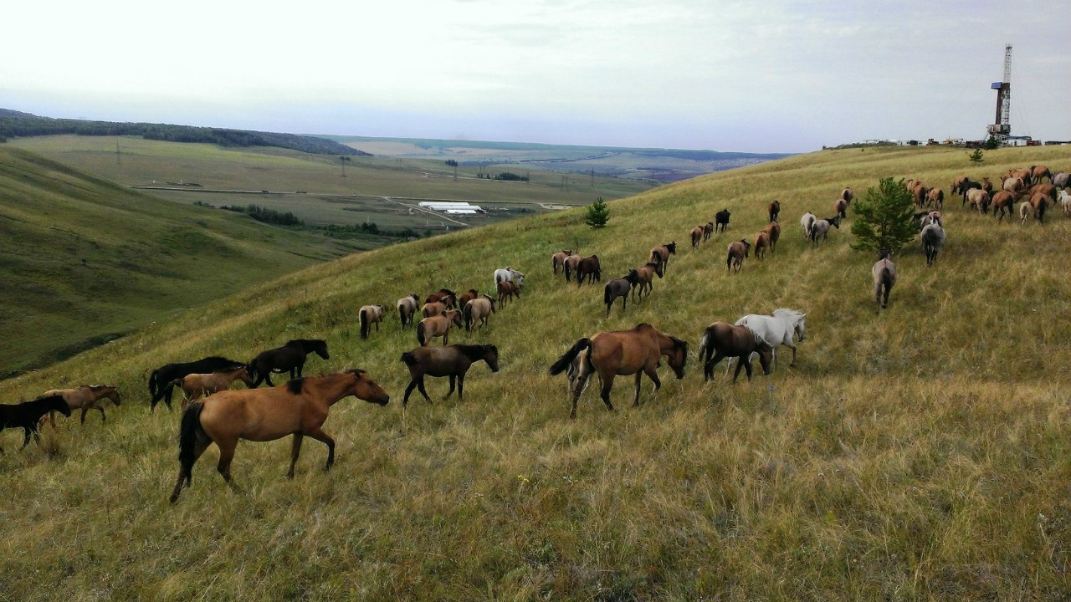
Horse Yard “Almakai”

Slide 2
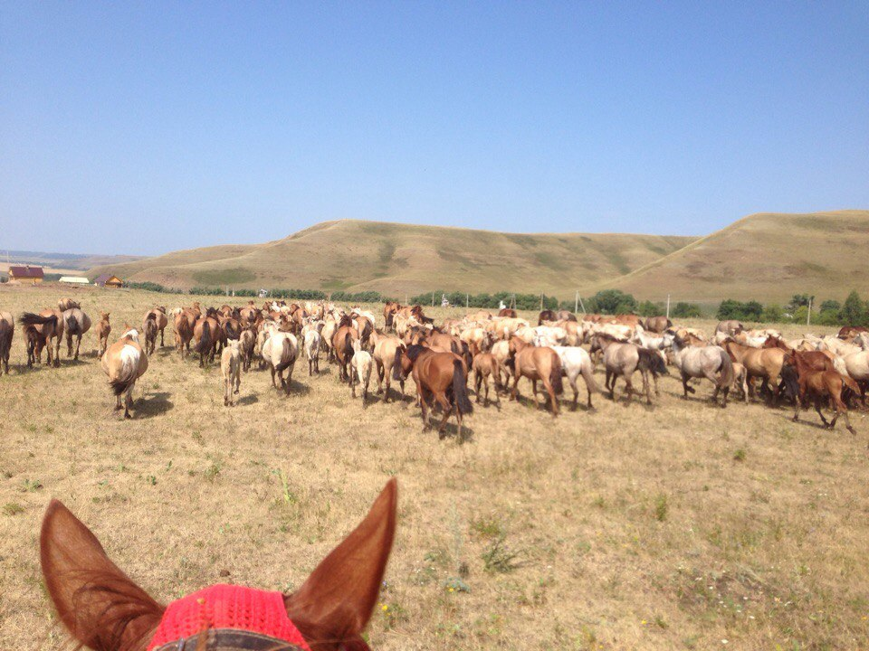
Horse yard was founded in 2011. The number of animals the was 20 horses. Yard started to breed only Tartar horses, after 5 years, in 2016, the number of horses is 230.

Slide 3
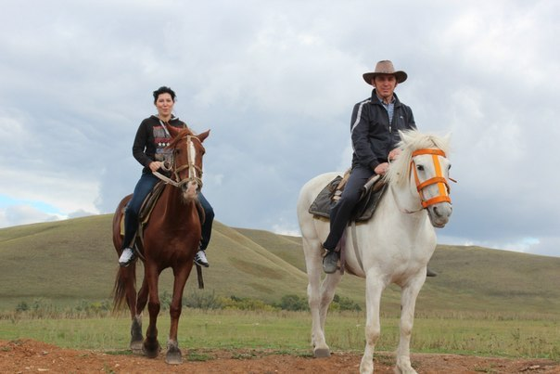
After some time, the farm began to support the government, developed courtyard expand their capabilities, soon began a ride on horses and excursions.

Slide 4
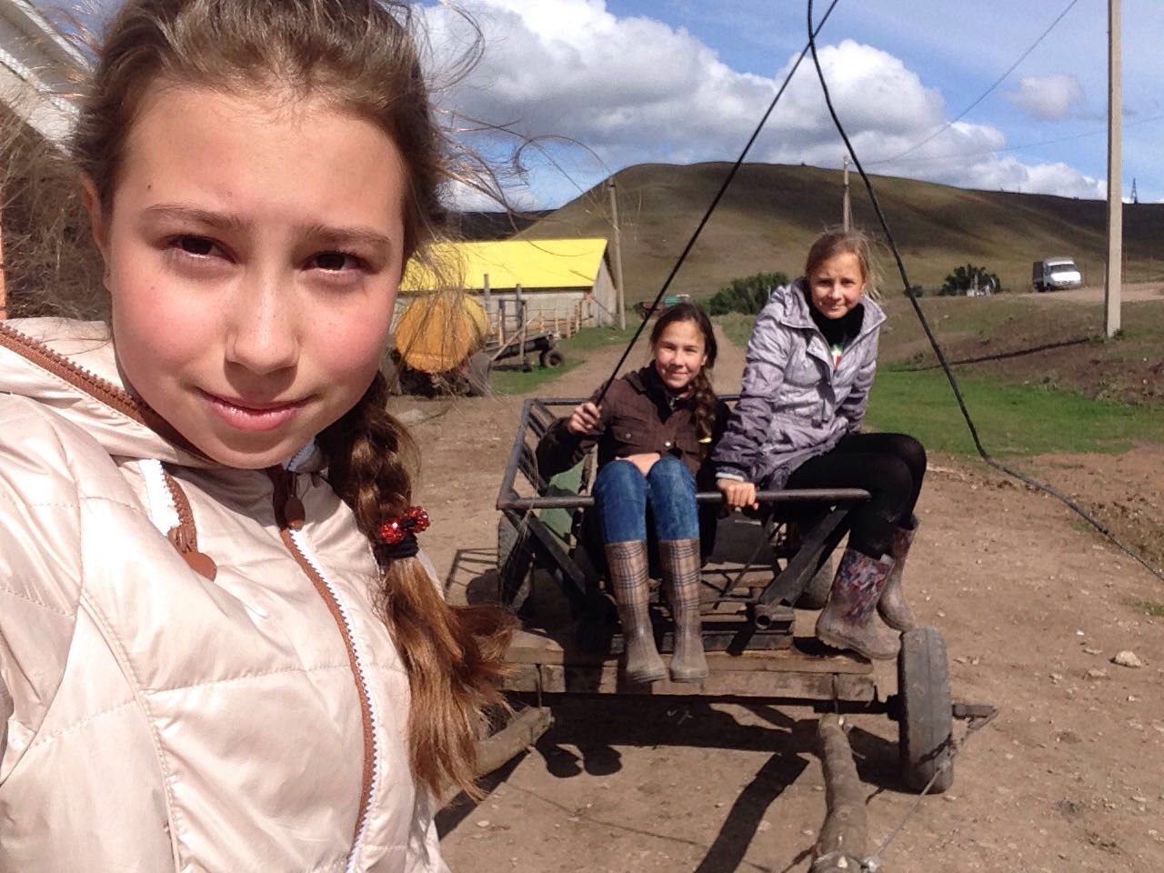
Also in Almakai there were new people and Almakai family began to grow, we have most of the girls, but we are very friendly, in fact we share a favorite, hobby horses.

Slide 5
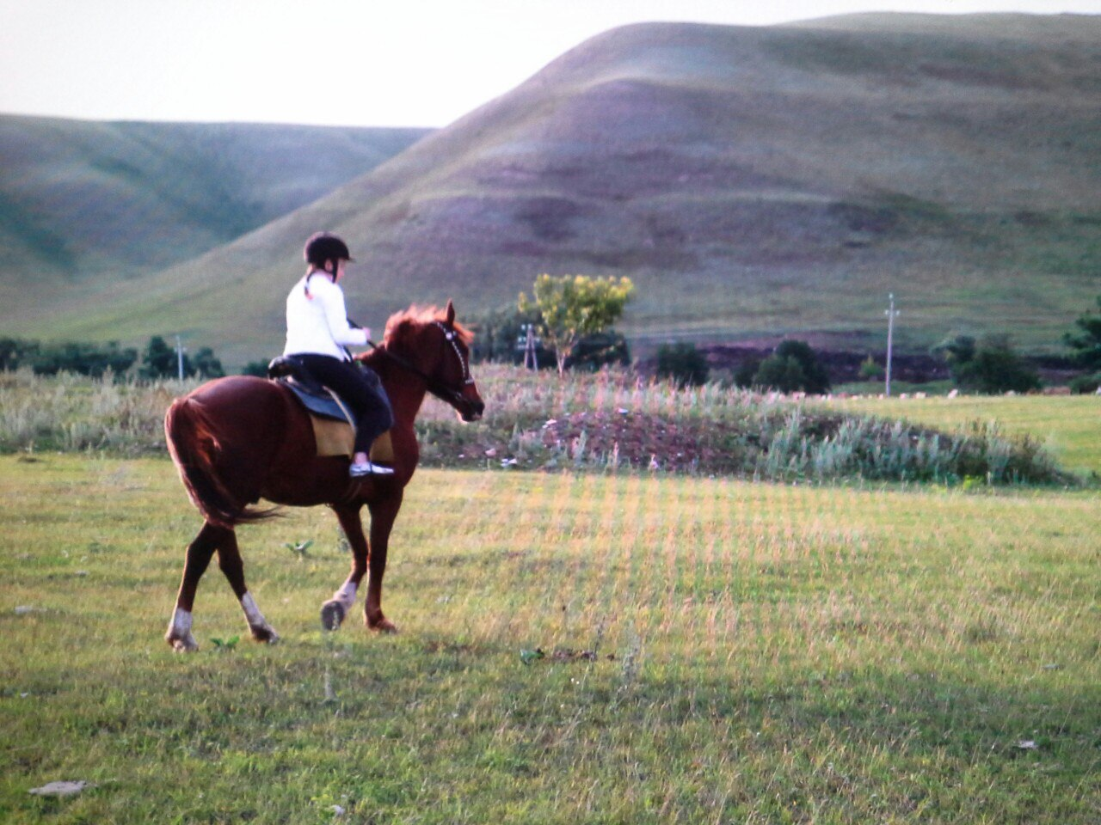
In Almakai performed procedure for the treatment of people with cerebral palsy. The time spent in the open air is also very good for health for people of all ages.

Slide 6
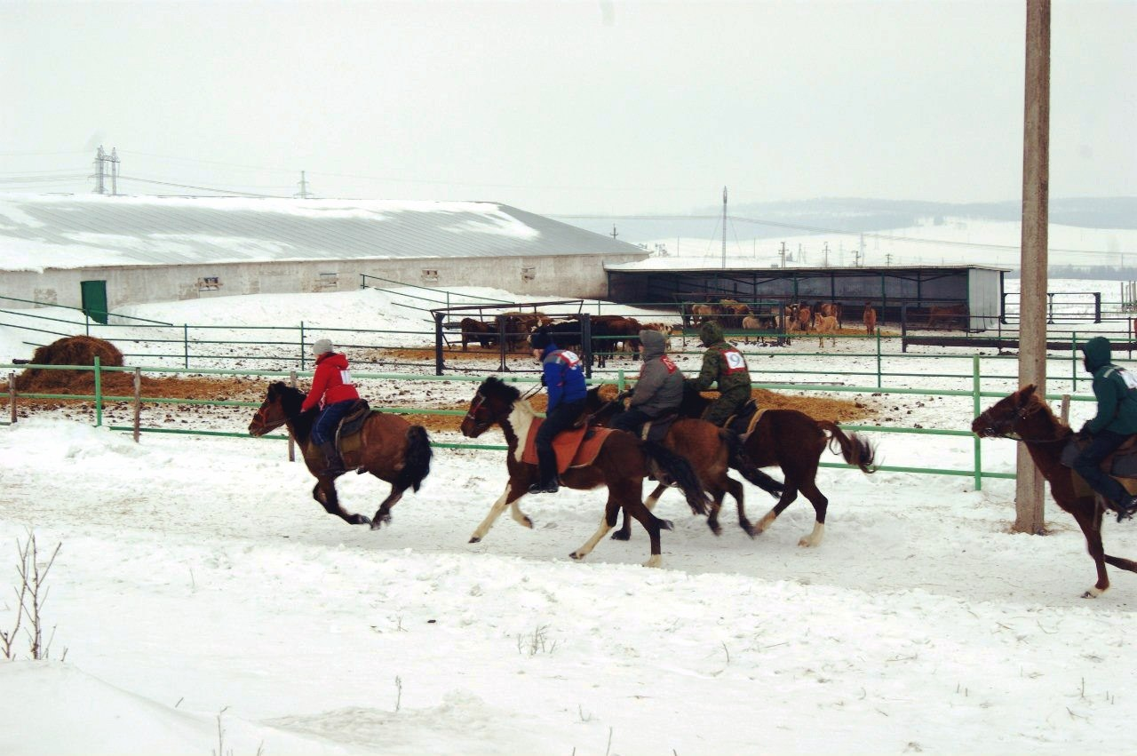
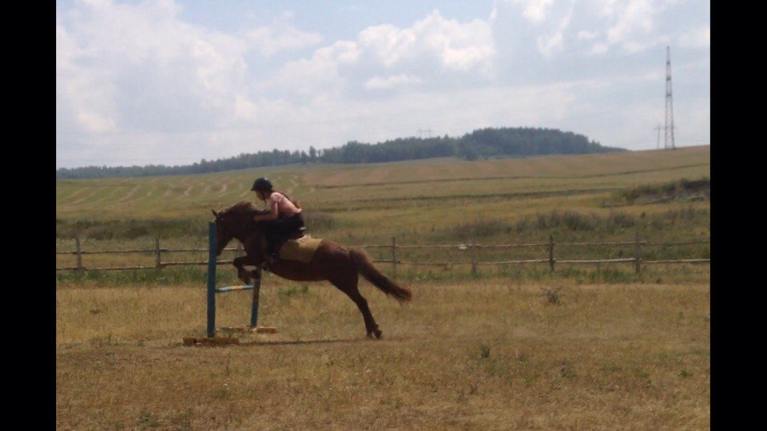
Every day we graze and feed horses, clean them, prepare for competitions.

Slide 7
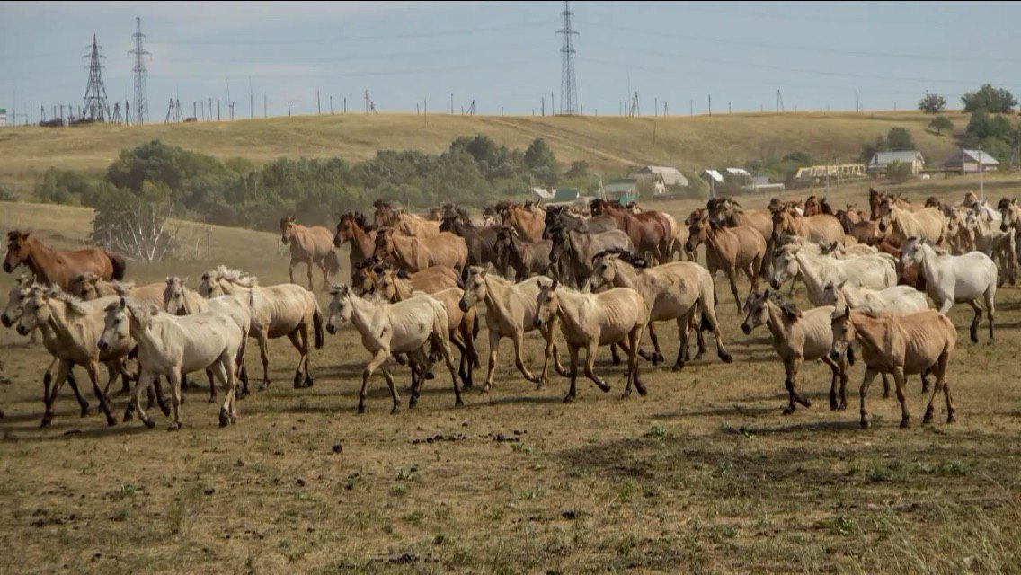
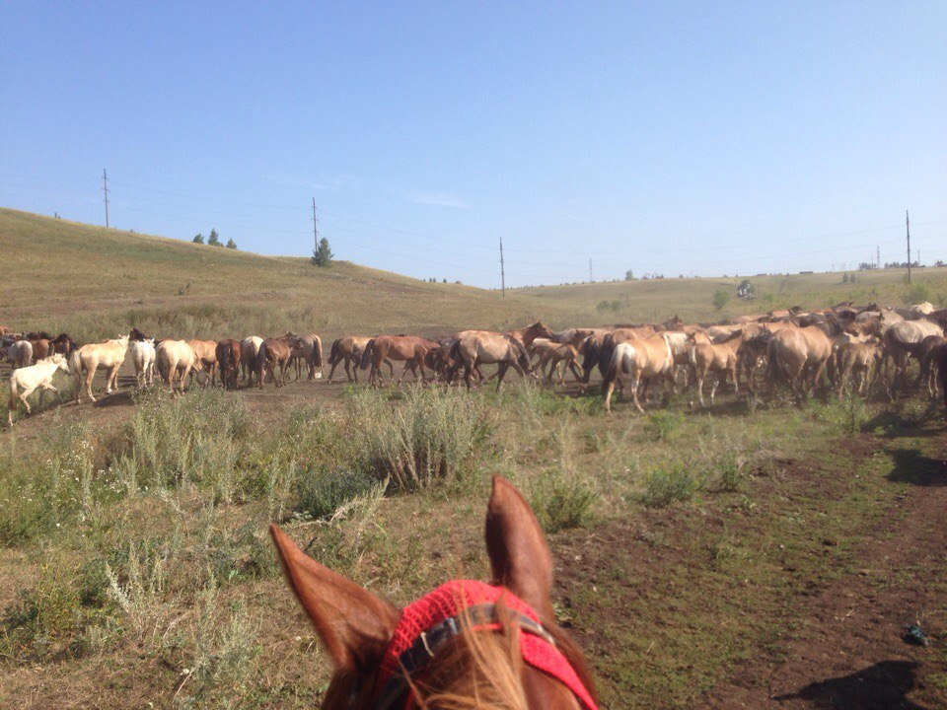

Slide 8
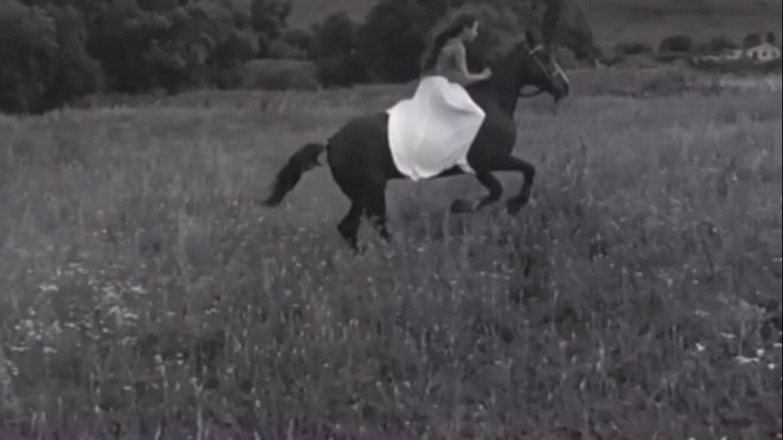
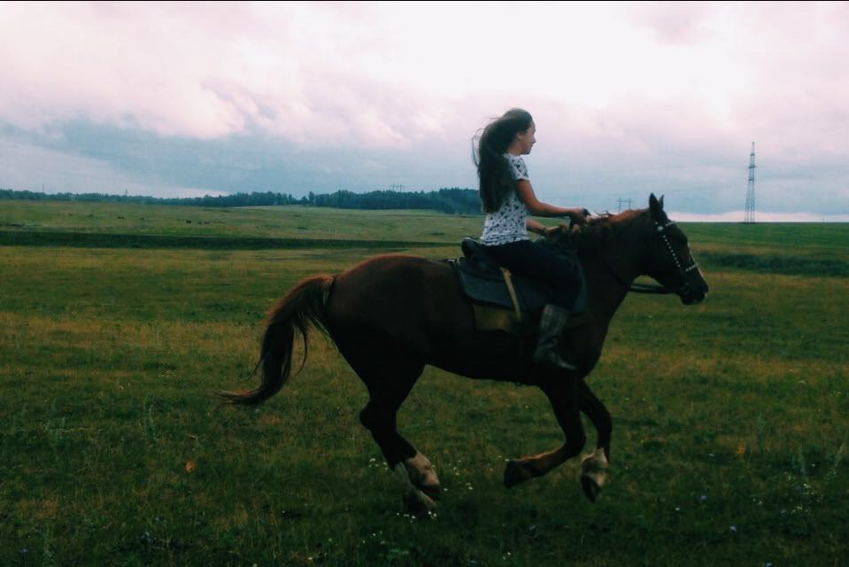
Horse beautiful and graceful animal, communicating with them awaken in us the beautiful feelings. No wonder they say, you can look at 3 things: fire burning, water flowing and galloping horse.

Slide 9
